Slide 1
JavaScript Juggernauts
Lesson 3.3
Notes:
630-35

Slide 2


This Will Soon Be You
JavaScript Juggernauts
Notes:
630-35

Slide 3

But Right Now You Might Feel Like
JavaScript Juggernauts
Notes:
630-35

Slide 4
Transformation to Come!
HANG IN THERE!
JavaScript Juggernauts
Notes:
630-35

Slide 5
Today’s Class
JavaScript Juggernauts
Notes:
630-35

Slide 6

Objectives
In today’s class, we’ll cover:
JavaScript Functions
JavaScript Objects
Building Simple JavaScript Applications
JavaScript Juggernauts
Notes:
630-35

Slide 7
JavaScript Functions
JavaScript Juggernauts
Notes:
635-35

Slide 8
26-SuperheroLogging Logging: No Functions
JavaScript Juggernauts
Notes:
635-40
No functions
Annoying to type
Hard to read
What happens if I want to change from “-” to “=“?
What if I want to lowercase the strings?
What if I want to alert?
What if I want to ellipsis when a string is long?

Slide 9
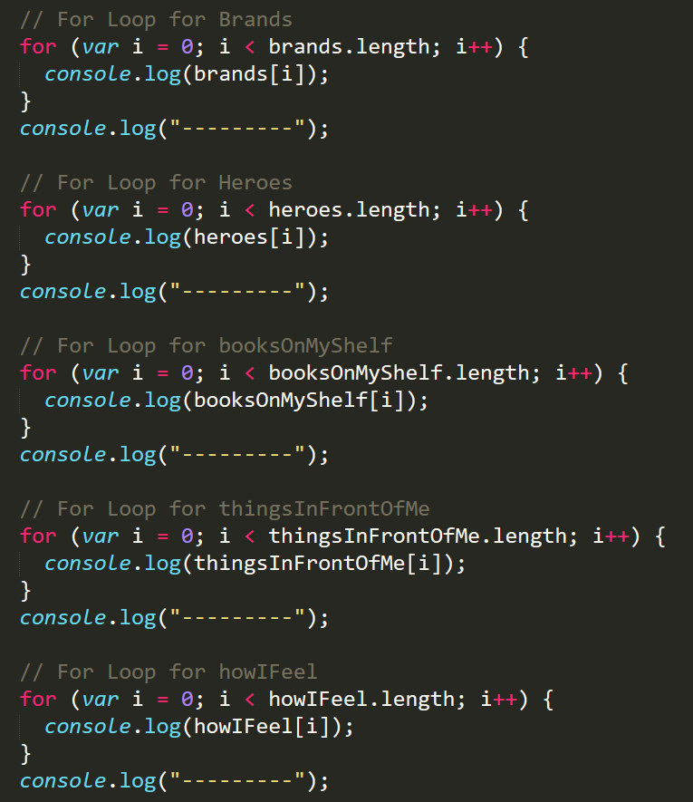


Mondo Repetitive
Who wants to maintain this?
Hint: No one.
JavaScript Juggernauts

Slide 10
Logging: With Functions
JavaScript Juggernauts
Notes:
640-50
With-functions
Just one loop now
Minimizes repetition (DRY)
We’ve been using functions for a while (indexOf, charAt, toLowerCase)
This is how we create functions
Easy to change ‘-’ to ‘=‘
Switch to alert
Notice that these functions are typically verbs
Add ellipsis if string is too long
if (content.length > 5) {
console.log(content.substring(0, 4) + '...');
} else {
console.log(content);
}
Function has a definition
That definition defines the name and parameters
When passing something in it’s an argument
Then we can “call” the function using parens

Slide 11
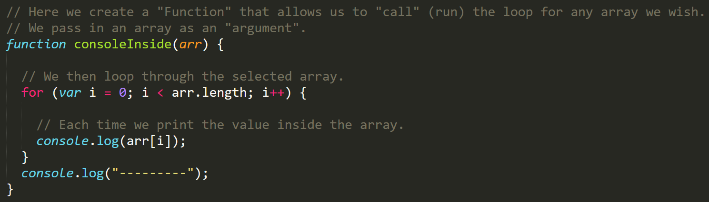
Much Better with Functions!
Squeaky clean code. Minimal repetition.
JavaScript Juggernauts

Slide 12
20 minutes
Partner Activity: My First Functions
JavaScript Juggernauts

Slide 13

Partner Activity: My First Functions (27-MyFirstFunctions)
Working in pairs fill in the missing functions and function calls.
Note: Try to finish all four functions if you can, but don’t be distressed if you only get 1 or 2. The important thing is that you get at least one function fully done.
HINT: Look back to the previous example if you need help.
JavaScript Juggernauts
Notes:
650-710 (20 min)
710-20 (review)
Everything requires one definition and at least one call (or else it’s dead code)
Return to hand back values (returns a value means it provides a value to the caller)
It’s up to the caller how they want to handle a returned value
It’s important to think about how your function will be used – what makes sense as options for parameters (what changes), what would be useful for the caller to receive, etc.

Slide 14
JavaScript Objects
JavaScript Juggernauts
Notes:
720

Slide 15
Good Arrays
JavaScript Juggernauts
Notes:
720-25
This is a good use case for an array
Arrays are good at holding related content

Slide 16
Joan of Arc (Bad Arrays)
JavaScript Juggernauts
Notes:
725-35
Notice this is a “.js” file
Implicitly related pieces of information
The first array is basically labels (or properties of Joan) and second has descriptions for those labels or properties
How would I try to associate these?
var input = 'Real Name';
var indexOfInput = joanOfArcInfoParts.indexOf(input);
console.log(joanOfArcInfoValues(indexOfInput));
We can connect each of these using indices but it won’t be extensible, readable or maintainable
When programming I think “what would happen if another program did…” a lot
What would happen if a programmer delete one of these values?
Arrays are not good at describing relationships

Slide 17
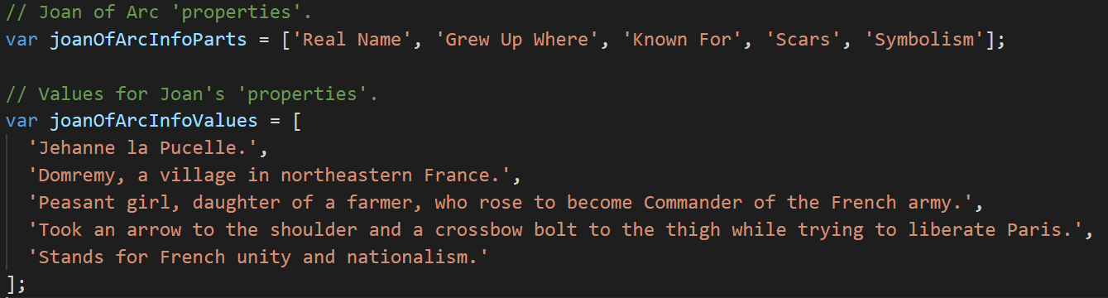
Associated Data ==/== Arrays
Relating two separate arrays is not fun.
JavaScript Juggernauts

Slide 18
Gandalf the Grey Objects
JavaScript Juggernauts
Notes:
735-45
Might want to take more time on this
Code the below
// Object properties can be accessed with 'bracket notation'
alert('My name is ' + gandalf['real name']);
// Or with 'dot notation' if the property has no spaces
if (gandalf.hasRetirementPlan) {
// Or with a variable that matches the name of the property
var ageProperty = 'age (est)';
var years = gandalf[ageProperty];
alert('My 401k has been gathering interest for ' + years + ' years!');
}
// You can access arrays and their properties from an object
alert('I have more than ' + gandalf.aliases.length + ' aliases');
// Non-existent properties return undefined
alert('My designation is ' + gandalf['designation']);
// Objects can also contain other objects, whose properties can be accessed by chaining dot notation
alert('My favorite song was written by ' + gandalf.favoriteSong.artist);
// Or with bracket notation
alert('My favorite song is ' + gandalf['favoriteSong']['name']);

Slide 19
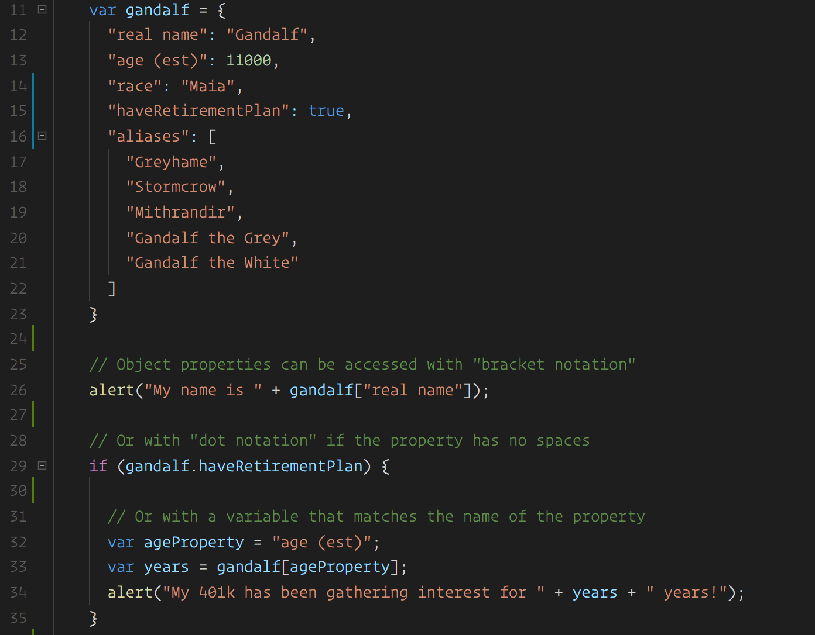
Gandalf: The Object
Gandalf’s properties and values are associated in object form, making it easy to recall specific data.
JavaScript Juggernauts
Notes:
745-50

Slide 20

Objects Visualized
This is Gandalf. According to code, Gandalf is an object.
var gandalf | = | {
“real name” | : | “Gandalf” | ,
“age (est)” | : | 11000 | ,
“race” | : | “Maia”
}
JavaScript Juggernauts
Notes:
745-50

Slide 21
Objects Visualized
These are Gandalf’s properties (like descriptors).
var gandalf | = | {
“real name” | : | “Gandalf” | ,
“age (est)” | : | 11000 | ,
“race” | : | “Maia”
}
JavaScript Juggernauts
Notes:
745-50

Slide 22
Objects Visualized
These are the values of Gandalf’s properties.
var gandalf | = | {
“real name” | : | “Gandalf” | ,
“age (est)” | : | 11000 | ,
“race” | : | “Maia”
}
JavaScript Juggernauts
Notes:
745-50

Slide 23
Objects Visualized
Thus: gandalf[“race”] = “Maia
var gandalf | = | {
“real name” | : | “Gandalf” | ,
“age (est)” | : | 11000 | ,
“race” | : | “Maia”
}
JavaScript Juggernauts
Notes:
745-50

Slide 24
Gandalf: The Grey Objects (Repeat)
JavaScript Juggernauts
Notes:
750-55
Go over it again
Point out object can contain other objects and we can chain notation
gandalf.favoriteSong.artist
Show reassignment of values

Slide 25
Group Activity (2 people): Basic Objects
JavaScript Juggernauts
Notes:
755-810 (15 minutes)

Slide 26
Group Activity: Basic Objects (31-MyFirstObject)
With a partner, spend the next few moments studying the code
Then, write code below each comment to log the relevant information about the provided car object.
Bonus: If you finish early, create a brand new object of your own. Slack out a snippet of the code to the class when you are done. Be Creative!
JavaScript Juggernauts
Notes:
755-810 (15 minutes)
810-25 (15 min)
BREAK!
825-35 (10 min)
Review
Notice that we have functions with a bit of a different syntax
These are methods – functions associated with an object are methods
We are using “this”
It’s a keyword to reference the object you are inside of
Later on we’ll make many “instances” of the same object and need “this” to differentiate them

Slide 28
32-CarGame: Run That Car!
JavaScript Juggernauts
Notes:
835-40
It’s a game that allows the user to provide inputs which call methods
We can play it forever – until cancel is pressed

Slide 29
Challenge: Run That Car!
JavaScript Juggernauts
Notes:
840-55 (15 min)

Slide 30
Challenge: Run That Car! (32-CarGame)
Using the code from the previous activity as a starting point, create an application such that:
Users can enter keyboard input (letters).
Each of the car's methods are assigned to a key.
When the user presses a key, it calls the appropriate function.
These letters also trigger a global function called rewriteStats() that logs the car's make, model, color, mileage, and isWorking status to the console.
Notes:
840-55 (15 min)
855-905
Review
Organized by variables, functions then calls to those functions
This is a helpful pattern you might want to use for HW3
Explain a while loop

Slide 31
Challenge: Question Game! (33-QuestionGame)
Create an array with 5 question objects
Ask the user each question (OK === true; Cancel === false)
Let the user know if they got the answer correct
Bonus: At the end tell the user how they did
Notes:
Everything is extra now
This one is low priority
Can say try this one at home
905-15 (10 min)
915-20 (5 min)
review

Slide 32
Challenge: The Window Object (34-WindowObject)
Read, analyze and debug window-object.html
Bonus: Try calling a window function we haven’t covered yet
Notes:
920-25 (5 min)
925-30
Review
Objects are useful for storing data and methods
There is a built-in object called window
This is a global variable – can be used everywhere (inside every function and outside)
Explain precedence of shadowed variables (passed in window and drink)

Slide 33
Challenge: Location Based Pages (35-LocationRedirect)
Alert which OS the user is using
Redirect to a page depending on their location
Notes:
930-32
Show the output (make sure it works first…)
Let them try this at home

Slide 34
Questions?
JavaScript Juggernauts

